Slide 1
Chapter 6: E-Customer relationship management and social CRM

Slide 2
Learning objectives
Understanding of e-CRM & social CRM
Assess the relevance of and alternative approaches for using digital platforms for customer relationship management by encouraging interactions through social media, mobile messaging and email marketing
Using digital technology and marketing automation to deliver more relevant interactions and encourage customer loyalty
Assess how to integrate social and mobile interactions to develop social CRM capabilities

Slide 3
Chapter content
E-CRM & social CRM
Customer lifecycle management strategy
Database and CRM
Using social media to improve customer loyalty and advocacy

Slide 4
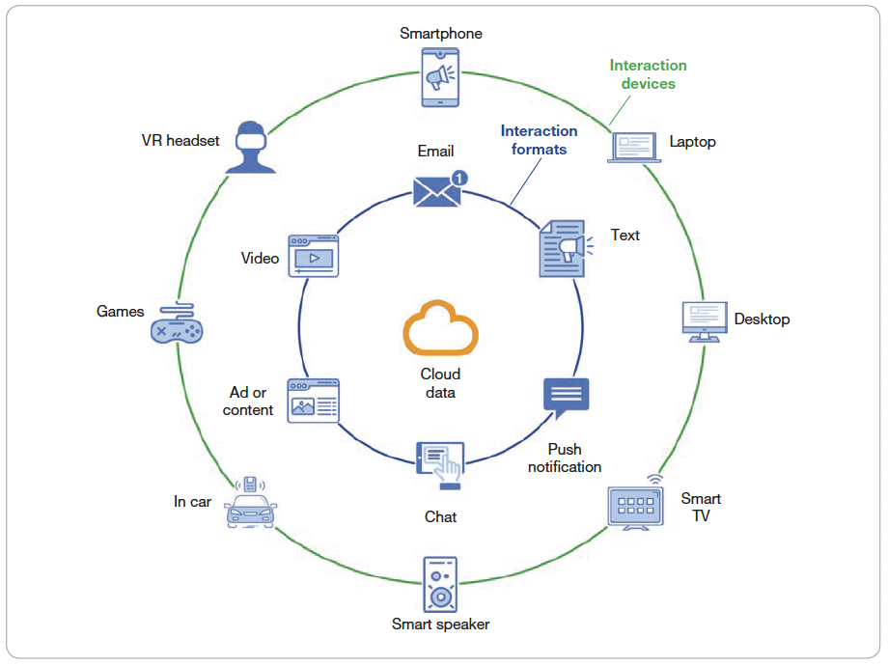
Introduction
- Relationship marketing, direct marketing and database marketing have combined to enable CRM.
-CRM systems are popular for supporting the applications that develop relationships with prospects and customers :
Marketing automation
Customer communications management
Sales force automation
Customer service management.
Analysis and reporting.
Figure 6.1 Digital communications options to support relationship development with online audiences using direct messaging
Notes:
Figure 6.3 Different consumer messaging options (Urban Airship, 2017)
It’s clear that there are many options for delivering communications. The challenge for marketers is that as the number of options and messages delivered has increased it has become more difficult to make an impact. Considering email, Radicati Group (2020) forecast that the total number of business and consumer emails sent each day will grow from 306 billion in 2020 to over 361 billion in 2024. They note that email is still the most pervasive form of electronic communication for both business and consumer users, so it is a key technique alongside mobile text and push notifications and emerging formats. On average, a consumer receives approximately 75 messages per day, so to gain ‘cut-through within the crowded inbox’ requires both creativity and targeting to deliver a relevant mes- sage. Other forms of personal messaging are increasing in importance, as catalogued by Datareportal (Kemp, 2021), which reported that, globally, three mobile messenger apps (WhatsApp, Facebook Messenger and Weixin/WeChat) had more than 1 billion monthly active users and a further three (QQ, Telegram and Snapchat) had more than half a bil- lion monthly users. These may not all offer the sophisticated targeting options of email marketing, but offer the potential to improve customer loyalty by interacting directly with individuals alongside push notifications in mobile apps and SMS text marketing. They’re particularly relevant for audiences that don’t use email marketing.
This increase in digital messaging highlights why a lifecycle customer relationship management strategy informed by data about customers is important to gain audience engagement through more person- alised messages that offer greater value than competitor messages, which are less relevant. This chapter details the data-driven analysis and personalisation techniques available to the marketer, showing through examples how they can be applied to B2B and B2C markets using marketing automation.
Marketing automation. Marketing automation and CRM systems such as Salesforce and Eloqua can be used to nurture prospects by sending a sequence of targeted email com- munications after they show initial interest in a service, for example after they download a case study or attend a webinar.
2 Sales force automation. Sales representatives are supported in their account management through tools to arrange and record customer visits. Today, within business-to-business marketing, these include support for social selling through services such as LinkedIn Navigator and account-based marketing (ABM) for larger organisations with multiple people in the buying unit. Automated tools also support sales cadences, which make it easy for sales people to send updates via email and LinkedIn to nurture prospects.
3 Customer service management. Representatives in contact centres respond to customer requests for information by using an intranet to access databases containing information on the customer, products and previous queries. It is more efficient and may increase customer convenience if customers are given the option of web self-service, i.e. access- ing support data through a web interface.
4 Customer communications management. Managing communications integrated across different channels including direct mail, email, mobile messaging, personalised web mes- sages and social networks.
5 Analysis and reporting. Reporting on the volume, quality and value of leads in the sales pipeline through techniques such as lead scoring and grading, which we describe in the section on permission marketing.

Slide 5
E-CRM
Electronic customer relationship management (e-CRM): using digital communication technologies to maximise sales to existing customers and encourage continued usage of online services. Today, CRM is synonymous with e-CRM. (Chaffey & Ellis-Chadwick, 2022, p.504)
Notes:
Quản trị quan hệ khách hàng điện tử (e-CRM): việc sử dụng công nghệ truyền thông số để tối đa doanh số từ khách hàng hiện tại và khuyến khích việc sử dụng các dịch vụ trực tuyến. Ngày nay, CRM được hiểu tương đương e-CRM (Chaffey & Ellis-Chadwick, 2022, p.504)

Slide 6
Benefits and challenges of e-CRM
Benefits :
Potential for relationship building
Create long-term value
Loyalty from customers
Be willing to share valuable data with businesses
Purchase intent increases exponentially with customers returning to the website
Chanllenge:
The challenges of keeping customers engaged with brands: short and long-term
95% opt-in users deleted or stopped using app if they received no notiifications within 90 days
Media fragmentation
Notes:
Benefits of using marketing automation to support customer engagement
Using digital platforms for CRM involves integrating the customer database with websites and messaging to make the relationship targeted and personalised. Through doing this, marketing can be improved by:
• Targeting more cost-effectively. Traditional targeting, for direct mail for instance, is often based on mailing lists compiled according to criteria that mean that not everyone con- tacted is in the target market. For example, a company wishing to acquire new affluent consumers may use postcodes to target areas with appropriate demographics, but within the postal district the population may be heterogeneous. The result of poor targeting will
• be low response rates, perhaps less than 1 per cent. Permission marketing. Also known as inbound marketing, this has the benefit that the list of contacts is self-selecting or pre-qualified. A company will only aim to build relation- ships with those who have visited a website and expressed an interest in its products by
• registering their name and address. Mass customisation of the marketing messages (and possibly the product). This automated personalisation process is described in a subsequent section. Technology makes it possible to send tailored emails at much lower cost than is possible with direct mail and also to provide tailored web pages to smaller groups of customers
• (microsegments). Increased depth and breadth of information (and improved nature of relationship). Digital media enables more information to be supplied to customers as required through content marketing. The nature of the relationship can be changed, in that contact with a customer can be made more frequently. The frequency of contact with the customer can be determined by the customers – whenever they have the need to visit their personalised pages – or they can be contacted by email by the company.
• Deeper customer understanding and more relevant communications can be delivered through a sense-and-respond approach. Examples of sense-and-respond communica- tions include: tools that summarise products purchased on-site and the searching behav- iour that occurred before these products were bought; online feedback forms about the site or products, completed when a customer requests free information; questions asked through forms or emails to the online customer service facilities; online questionnaires asking about product category interests and opinions on competitors; new product devel- opment evaluation – commenting on prototypes of new products.
Lower cost. Contacting customers by email or through their viewing web pages costs less than using physical mail, but, perhaps more importantly, information needs to be sent only to those customers who have expressed a preference for it, resulting in fewer
an automated contact strategy, based on assessment of their position in the customer lifecycle and monitoring • specific interactions with
a company’s website, emails and staff.
Gamification
The process of applying game thinking and mechanics to engage an audience by rewarding them for achievements and sharing.
• mail-outs. Delivering loyalty programmes. Loyalty schemes are often used to encourage customer
• extension and retention. You will be familiar with points-based schemes run by retailers. Opportunities for gamification. Gamification involves applying game-based thinking to a brand, business or organisation to engage and develop loyalty. Research shows that game play itself stimulates the human brain (releasing dopamine) and the now-proven mechanics from gaming can be brought into marketing, and especially mobile marketing. Some key features of gamification applied to digital marketing are:
creative concept to engage;
game mechanics to encourage play (badges, points, leader boards levels, interactions);
game dynamics can be altered to reward and even penalise;
game currencies to provide the motivation – this can be financial, status, need for doing
good, pleasure and influence.
Lợi ích:
Tiềm năng xây dựng quan hệ
Tạo giá trị dài hạn
Lòng trung thành từ khách hàng
Sẵn sàng chia sẻ dữ liệu quý giá với doanh nghiệp
Ý định mua hàng tăng theo cấp số nhân với khách hàng quay lại website
Thách thức:
Không thể kiểm soát nội dung liên quan đến thương hiệu của khách hàng
Thách thức công nghệ và văn hoá quản lý
Customer engagement is sometimes used to refer to engaging customers in the short term, for a single touchpoint, such as whether someone dwells on the site for a significant time or whether they interact with an email. Customer engagement also refers to the long- term ability of a brand to gain a customer’s attention on an ongoing basis.
The commercial aim of engagement is to maximise customer value through using cus- tomer interactions to lead to more profitable relationships.
An example of the challenge and the need for automated reminder messages for consum- ers to engage is provided by mobile messaging service AirshipTM (2017), which researched the impact of push notifications on new mobile app users. It found that within 90 days of first opening the app, 95 per cent of opt-in users in the study who didn’t receive any push notifications churned – that is, they deleted or stopped using the app. In contrast, app users who received push notifications in the 90 days after their first opening of the app had nearly three times (190 per cent) higher retention rates than those who did not.
Media fragmentation
Describes a trend towards increasing choice and consumption of a range of media in terms of different channels such
as web and mobile and also within channels – for example, more TV channels, radio stations, magazines, more websites. Media fragmentation implies increased difficulty in reaching target audiences.

Slide 7
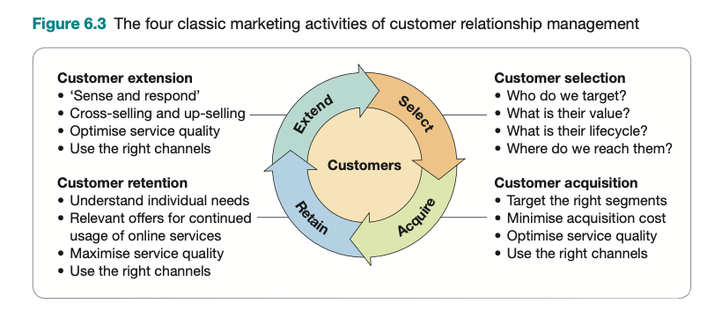
Customer lifecycle management strategy
Notes:
Customer selection means defining the types of customers that a company will market to. It means identifying different groups of customers for which to develop offerings and to target during acquisition, retention and extension. Different ways of segmenting customers by value and by their detailed lifecycle with the company are reviewed.
2 Customer acquisition refers to marketing activities to form relationships with new cus- tomers while minimising acquisition costs and targeting high-value customers. Service quality and selecting the right channels for different customers are important at this stage and throughout the lifecycle. For an online business, acquisition may involve a single- step conversion – for example, if a new visitor arrives on a site and purchases on the first visit. Typically, a longer, multi-step process is needed for conversion to sale where a visitor returns to the site. To facilitate conversion, customer lifecycle marketing should seek to form an initial relationship through asking for contact details for communication, such as email address, mobile number or a social media contact. This is the permission marketing approach, which we explain in the next section. For online SaaS startups, there is an additional step of activation, which means that a person registered with an online brand takes further action(s), such as trying the service.
3 Customer retention refers to the marketing activities employed by an organisation to keep its existing customers, i.e. to encourage them to buy again or continue a contract that renews for a service. Identifying relevant offerings based on their individual needs and detailed position in the customer lifecycle (e.g. number and value of purchases) is key.
4 Customer extension refers to increasing the depth or range of products that a customer purchases from a company. This is often referred to as ‘customer development’.
Re-sell. Selling similar products to existing customers – particularly important in some • B2B contexts as rebuys or modified rebuys.
Cross-sell. Selling additional products that may be closely related to the original purchase, but not necessarily so.
Up-sell. A subset of cross-selling, but in this case selling more expensive products.
Reactivation. Customers who have not purchased for some time, or have lapsed, can be encouraged to purchase again.
Referrals. Generating sales from recommendations from existing customers – for exam- ple, member-get-member deals.

Slide 8
Permission marketing
Permission marketing is a significant concept that still underpins online CRM in management of the customer lifecycle.
‘Permission marketing’ is a term coined by Seth Godin (1999). It is best characterized with just three (or four) words:
anticipated
relevant
personal
[and timely.]
… Customers agree (opt-in) to be involved in an organization’s marketing activities, usually as a result of an incentive.
Notes:
Digital Marketing Strategy, P. 242
Permission marketing is . . . anticipated, relevant and personal [and timely].
kỳ vọng
iên quan
cá nhân
(đúng thời điểm)

Slide 9
Effective process for permission-based online relationship building
Stage 1. Attract new and existing customers to online presence.
Stage 2a. Prompt and incentivize visitors to action: Two key types of incentives to consider are: lead generation offers and sales generation offers
Stage 2b. Capture customer information to maintain relationship
Stage 3: Initiate dialogue using online communication with an effective welcome sequence of multiple emails. Stage 4. Maintain dialogue using relevant online and (where needed) offline communication.
Notes:
Stage 1. Attract new and existing customers to online presence. Digital inbound com- munications and offline communications channels described in Chapter 9, such as search, social media marketing and direct mail, are used to drive visitors to a website, Facebook or other form of presence such as an app that enables opt-in. In B2B marketing visitors can be
• directed to a dedicated landing page by paid media such as Google Ads or LinkedIn ads. Stage 2a. Prompt and incentivise visitors to action. Two key types of incentives to con- sider are: lead generation offers and sales generation offers, such as the discount cou- pon shown in Figure 6.4 (1). This features a ‘lightbox’ or ‘pop-up’, which is commonly used in B2C markets to ensure the site visitor views the offer and responds. Less inter- ruptive panels at the foot of the page can also be used.
Types of offers marketers can devise include information value, entertainment value, monetary value and privileged access to information The beauty of digital marketing is that different offers can be tested for different audiences using AB or multivariate testing (Chapter 10) and the offers refined to increase response.
To get visitors to take notice, prominent calls-to-action or pop-ups can boost conver- sion rates. For example, a pop-up to encourage free subscription which was resisted by Dave Chaffey for several years, increased lead conversion by 40 per cent when deployed on Smart Insights. Many web users will be annoyed by pop-ups, yet for site owners they do increase the number of leads, so the number of pop-ups is now increasing and is likely to do so further.
• Stage 2b. Capture customer information to maintain relationship. Capturing profile infor- mation is commonly achieved through an online form such as that within the lightbox shown in Figure 6.4 (1), which the customer must complete to receive the offer. It is impor- tant to design these forms to maximise their completion. Factors that are important are: • branding to reassure the customer;
• key profile fields to capture the most important information to segment the customer for future communications – for example, postcode, airport and preferred activities
(not too many questions should be asked); mandatory fields – mark fields that must be completed or, as in this case, only include
mandatory options, in this case to select an interest in clothing; privacy – ‘we will not share’ is the magic phrase to counter the customer’s main fear of their details being passed on; a full privacy statement should be available for those
who need it;
KISS – ‘Keep it simple, stupid’ is a well-known American phrase;
WIFM – ‘What’s in it for me?’ Explain why the customer’s data is being captured; what
benefits it will give them;
validation – of email, postcode etc., checking data as far as possible to make it accurate.
As well as online data capture, it is important to use all customer touchpoints to capture information and keep it up to date, since this affects the ability to target customers accu- rately. Figure 6.5 provides a good way for a company to review all the possible methods of capturing email addresses and other profile information.
Apart from the contact information, customer profiling information is also important so that relevant content and offers can be delivered to them. For example, B2B company RS Components asks for:
• industry sector; • purchasing influence; • specific areas of product interest; • how many people you manage; • total number of employees in company.
Once initial data about a customer has been collected, it can be enriched by adding other data to gain a better understanding of customer needs and behaviours. This is sometimes known as progressive profiling. The risk here is that if data is entered into different systems, data quality issues may arise with inaccurate data. Management measures should be put in place to create an accurate single customer view. This is a significant issue with CRM systems since data can be collected offline and in different online systems such as on the website, transactional e-commerce, or within social media and a separate email system.
•
Stage 3: Initiate dialogue using online communication. To build the relationship between company and customer it’s common to send a welcome email as shown in Figure 6.4.( 2) or a mobile message. This may provide a discount, but should also communicate brand positioning and online value proposition. Clinique provides a good example of a brand
Chapter 6 Data-driven relationship marketing using digital platforms 245
• with an effective welcome sequence of multiple emails. Stage 4. Maintain dialogue using relevant online and (where needed) offline communica- tion. After an initial welcome sequence, it’s common to send a newsletter or campaign emails to showcase a brand’s offer to the prospect or customer. In Figure 6.4 (3) the e-newsletter is tailored using dynamic content insertion, where the customer preferences are accessed from the CRM database to recommend relevant products based on what they have browsed on the site or purchased previously.
Direct mail or phone contact may still be cost-effective forms of communication, particu- larly within B2B markets, since these can also be tailored and may have more ‘cut-through’ compared to an email. With direct mail campaigns the aim may be to drive traffic to the website in a web response campaign using techniques such as:
online competition;
online web seminar (webinar);
sales promotion.
A further objective in stages 3 and 4 is to improve customer information quality. In par- ticular, emails may bounce – in which case offline touchpoints need to be planned to contact customers for their latest addresses.
With the advent of social media marketing, the permission marketing concept has been applied to social networks where opt-in involves ‘liking’ a brand on Facebook or following a company on Twitter, LinkedIn or Instagram. Of course, email offers a key benefit over social media channels since messages can be tailored to the individual.
đề xuất ưu đãi cho người tham gia
khi KH chú ý, đề xuất chương trình chung và đưa thông tin về sản phẩm/dịch vụ
nhấn mạnh yếu tố ưu đãi để đảm bảo đề xuất có thể duy trì được sự cho phép của KH
đề xuất thêm các ưu đãi khác nhau để xin được sự cho phép của KH về các khía cạnh khác nhau
dần dần, thông qua sự cho phép của KH, chuyển hoá hành vi của NTD thành lợi nhuận

Slide 10
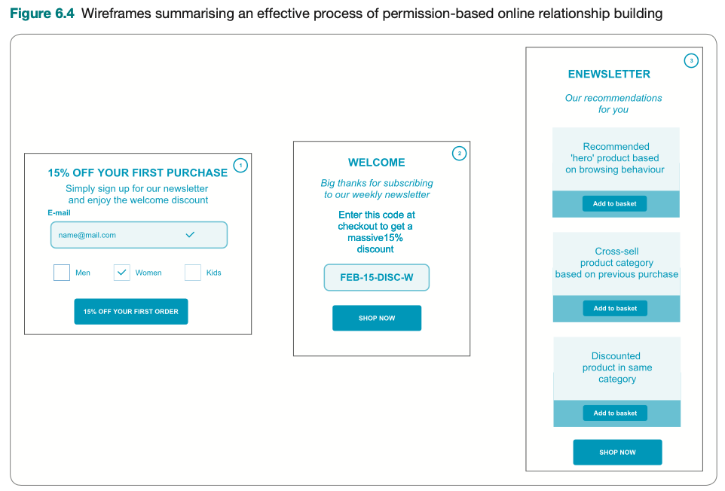

Slide 11
E-permission marketing principles
Principle 1. Consider selective opt-in to communications
Principle 2. Create a ‘common customer profile’.
Principle 3. Offer a range of opt-in incentives.
Principle 4. Don’t make opt-out too easy.
Principle 5. Watch, don’t ask (or ‘sense and respond’)
Principle 6. Create an outbound contact strategy
Notes:
Principle 1. Consider selective opt-in to communications. In other words, offer choice in communications preferences to the customer to ensure more relevant communications. Some customers may not want a weekly e-newsletter; rather, they may only want to hear about new product releases. Remember opt-in is a legal requirement in many countries. Three key communications preferences options, selected by tick box, are:
• content – news, products, offers, events; • frequency – daily, weekly, monthly, quarterly alerts or digests; • channel – email, social network, direct mail, phone or SMS.
Principle 2. Create a ‘common customer profile’. A structured approach to customer data capture is needed, otherwise some data will be missed – as is the case with the utility company that collected 80,000 email addresses, but forgot to ask for the post- code for geo-targeting! This can be achieved through a common customer profile – a definition of all the database fields that are relevant to the marketer in order to under- stand and target the customer with a relevant offering. The customer profile can have different levels to set targets for data quality (level 1 is contact details and key profile fields only, level 2 includes preferences and level 3 includes full purchase and response
behaviour). Principle 3. Offer a range of opt-in incentives. Many websites now have ‘free–win–save’ incentives to encourage opt-in, but often it is one incentive fits all visitors. A bundle of incentives or different incentives for different audiences will generate a higher volume of
permission, particularly for business-to-business websites. Principle 4. Don’t make opt-out too easy. Often marketers make it too easy to unsub- scribe. Offering some form of opt-out is now a legal requirement in many countries due to privacy laws and can help deliverability rates for email. However, wise permission marketers such as Amazon use the concept of ‘My Profile’ or a ‘selective opt-out’. Instead of unsubscribe, they offer a link to a ‘communications preferences centre’ web form to update a profile that includes the option to reduce communications, which may be the
• option taken rather than unsubscribing completely. Principle 5. Watch, don’t ask (or ‘sense and respond’). The need to ask interruptive ques- tions can be reduced through the use of monitoring clicks to better understand customer needs and to trigger follow-up communications. Some examples include: • monitoring click-through to different types of content or offer; • monitoring the engagement of individual customers with email communications;
• • follow-up reminders to those who don’t open the email first time. Principle 6. Create an outbound contact strategy. Online permission marketers need a plan for the number, frequency and type of online and offline communications and offers. This is a contact or touch strategy, which is particularly important for large organisa- tions with several marketers responsible for email communications. We describe contact strategies in more depth in the next section.
Say and Southwell (2006) give an example of a permission-based campaign to promote a new interactive banking service. The campaign objectives and results (in brackets) were to:
• capture 5,000 mobile phone numbers from customers (200 per cent of plan); • acquire 3,000 email addresses (176 per cent of plan); • raise awareness about the new service (31,000 customers viewed demonstration); • create 1,000 new registrations (576 per cent of plan).

Slide 12
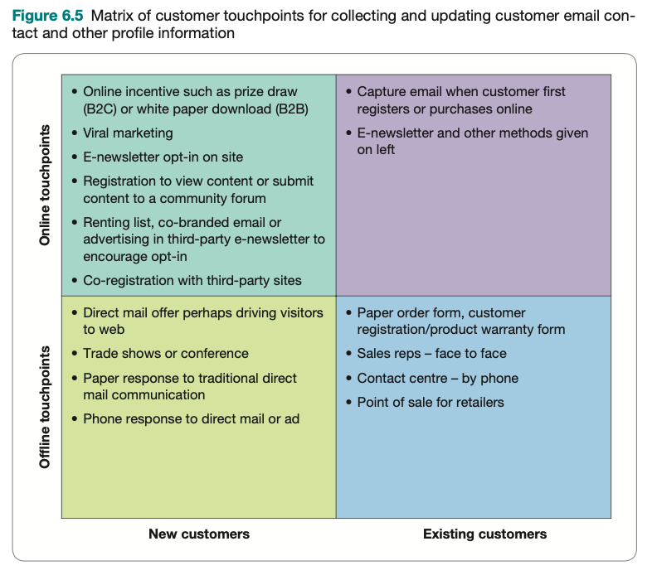
The possible methods of capturing email addresses and other profile information.

Slide 13
Prolifing leads with lead scoring and lead grading
Lead scoring and lead grading are data-driven marketing techniques often used for high-value B2B marketing services, which assess a person’s profile and behavior to determine whether they have the potential to become a customer, i.e. are they a ‘hot lead’ or less likely to convert.
Lead scoring and grading enables businesses to:
prioritize their time in contacting prospects by phone to ask about their interest in a service.
target email, text messages, or ads to people with different levels of interest and fit.
Notes:
Khi đã có sự đồng ý tham gia của khách hàng, cần tận dụng tối đa nguồn lực
Không thể theo đuổi tất cả khách hàng, mà cần có sự chọn lọc
Kỹ thuật marketing dựa trên dữ liệu để đánh giá hồ sơ và hành vi khách hàng để xác định tiềm năng
Giúp doanh nghiệp tối ưu hoạt động tiếp cận khách hàng
Áp dụng cho điện thoại, email, sms, hoặc quảng cáo.

Slide 14
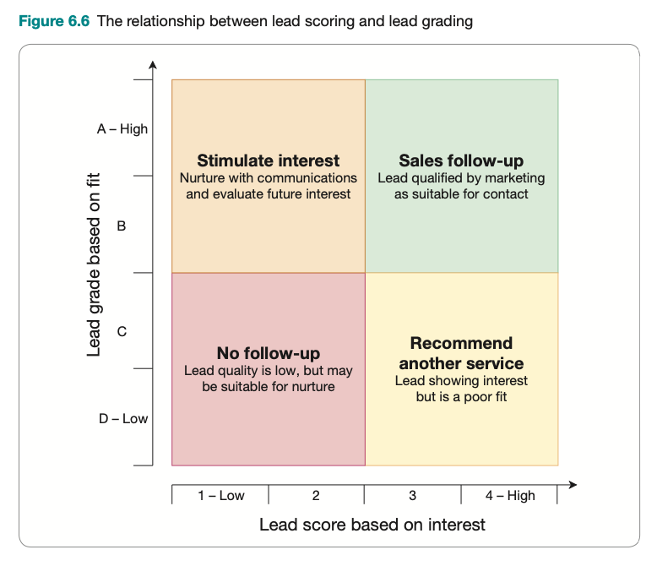
Prolifing leads with lead scoring and lead grading
MQL (marketing qualified lead), typically warrant follow-up by a phone call and, if they are confirmed as a suitable fit, will be recorded as sales-qualified leads (SQLs) in the CRM system.
People with lower scores such as C1, C2 or B3, B4 are added to lead nurture segments where there is no proactive approach to contact leads since the purchase may not occur immediately.
I 1-high I 2 I 3 I 4-low I
Notes:
Lead scoring and grading enables businesses to prioritise their time in contacting prospects by phone to ask about their interest in a service. It can also be used to target email, text messages or ads to people with different levels of interest and fit. Most marketing automation systems such as Salesforce Pardot and HubSpot use a scoring sys- tem like this to represent lead scoring and grading, although these features are not always used. Consultants experienced in lead scoring may be required to customise the marketing automation system for each business,
The highest-quality leads categorised as marketing-qualified leads (MQLs) typically warrant follow-up by a phone call and, if they are confirmed as a suitable fit, will be recorded as sales-qualified leads (SQLs) in the CRM system. SiriusDecisions (Aguiar, 2018) explains the different types of MQLs and SQLs in more detail in its Demand Water- fall process.
Note that the system is not precise, since a lead may show a good fit but may not have interacted much on the website since they received information elsewhere, such as at a trade show. For this reason, manual inspection of all leads may also be valuable. For expensive B2B services, account-based marketing (ABM) techniques may be used to identify other people in the decision-making unit that are also involved in deciding on a purchase. This involves identifying multiple people from a company to target, for which LinkedIn Sales Navigator can be used, and then contacting them through social selling or phone-based prospecting.
People with lower scores such as C1, C2 or B3, B4 are added to lead nurture segments where there is no proactive approach to contact leads since the purchase may not occur immediately.

Slide 15
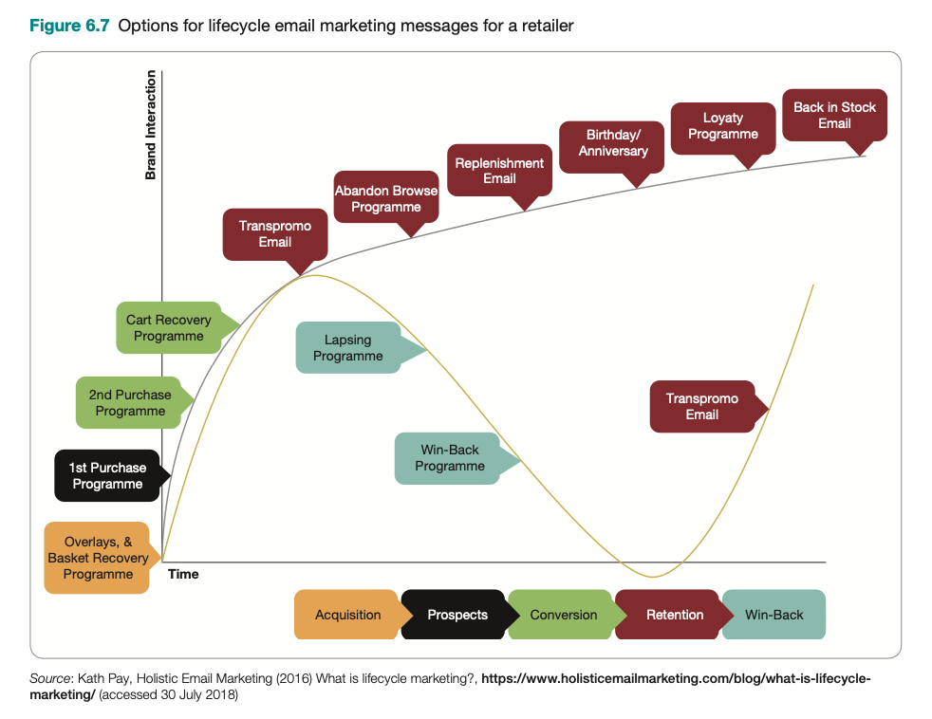
Contact strategies
Contact strategies define the trigger, aims, messaging, offer and time interval for communications is a vital skill to develop the most effective customer communications programme.
Notes:
Defining contact strategies
Developing contact strategies that define the trigger, aims, messaging, offer and time interval for communications is a vital skill to develop the most effective customer communications programme. Figure 6.7 shows recommendations of different contact strategies from Kath Pay, an email marketing automation consultant who created this visual to show the oppor- tunity for retailers to communicate with their audiences via email

Slide 16
Lifetime value modelling
Lifetime value (LTV) is the total net benefit that a customer or group of customers will provide a company over their total relationship with that company.
By applying statistical models, they can predict not only when each customer is likely to make a future purchase but also what he or she will buy and through which channel. Managers can use these data to estimate a potential lifetime value for every customer and to determine whether, when and how to contact each one to maximise the chances of realising (and even increasing) his or her value. (Kumar et al. 2007)
Notes:
Contacting strategy, of course, is not fired en masse. Activities should focus on customer that is qualified, to avoid waste of resource., especially when acquiring a new customer is so expensive; it is naturally to want to know whether the amount we pay is worth the value. To help with this process, organisations can estimate customer’s lifetime value,

Slide 17
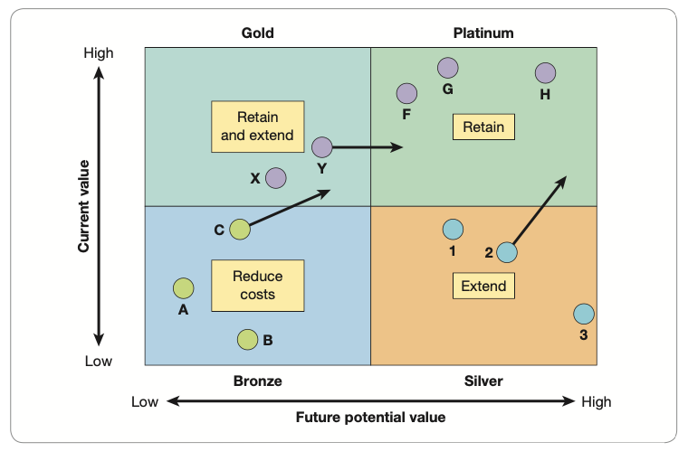
An example of an LTV-based segmentation plan

Slide 18
RFM analysis (recency-frequency-monetary)
Recency
This is the recency of customer action, e.g. purchase, site visit, account access, email response.
Frenquency
Frequency is the number of times an action is completed in a period of a customer action – e.g. purchase, visit, email response (for example, five purchases per year, five visits per month, five log-ins per week, five email opens per month, five email clicks per year)
Monetary value
The monetary value of purchase(s) can be measured in different ways – for example, average order value of £50, total annual purchase value of £5,000.

Slide 19
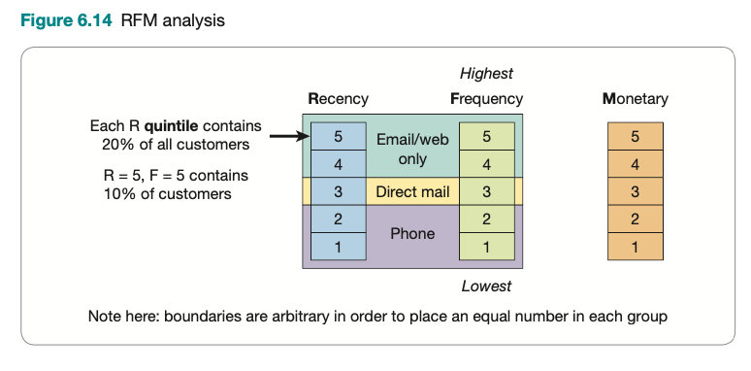
Example of RFM analysis

Slide 20
Product recommendations and propensity modeling
Propensity modeling: The approach of evaluating customer characteristics and behaviour and then making recommendations for future products; recently, using machine learning/AI
Create automatic product relationships (i.e. next-best product). A low-tech approach to this is, for each product, to group together products previously purchased together. Then for each product, rank product by number of times purchased together to find relationships.
Cordon off and minimise the ‘real estate’ devoted to related products. An area of screen should be reserved for ‘next-best product prompts’ for up-selling and cross-selling. How- ever, if these can be made part of the current product, they may be more effective.
Use familiar ‘trigger words’. That is, familiar from using other sites such as Amazon. Such phrases include: ‘Related products’, ‘Your recommendations’, ‘Similar’, ‘Customers who bought . . . ’, ‘Top 3 related products’.
Editorialise about related products. That is, within copy about a product.
Allow quick purchase of related products. For example, through prompts to purchase specific products labeled ‘Recommended products’ or ‘Bought by other customers’.
Sell related products during checkout. And also on post-transaction pages, i.e. after one item has been added to the basket or purchased.

Slide 21
Social CRM
Social CRM: The process of managing customer-to-customer conversations to engage existing customers, prospects and other stakeholders with a brand and so enhance customer relationship management.
Social proof: Consumer psychology research shows that potential customers trust recommendations from others, so communicating social proof in different formats can increase conversion. Forms of social proof include customer reviews, ratings, testimonials and case studies, and independent validation by an influencer or recognized trustworthy sources. Numbers showing the size of the company and brand idents can also communicate social proof.
Organic social media marketing: Organic social involves using social networks and customer communities to develop relationships, share positive opinions through social media amplification and manage negative social media comments.
Notes:
Digital marketing strategy, p. 271
Finally, communications to consumer cannot ignore social media
In CRM, social media is THE channel to manage relationship
Social CRM
The process of managing customer-to-customer conversations to engage existing customers, prospects and other stakeholders with a brand and so enhance customer relationship management.

Slide 22
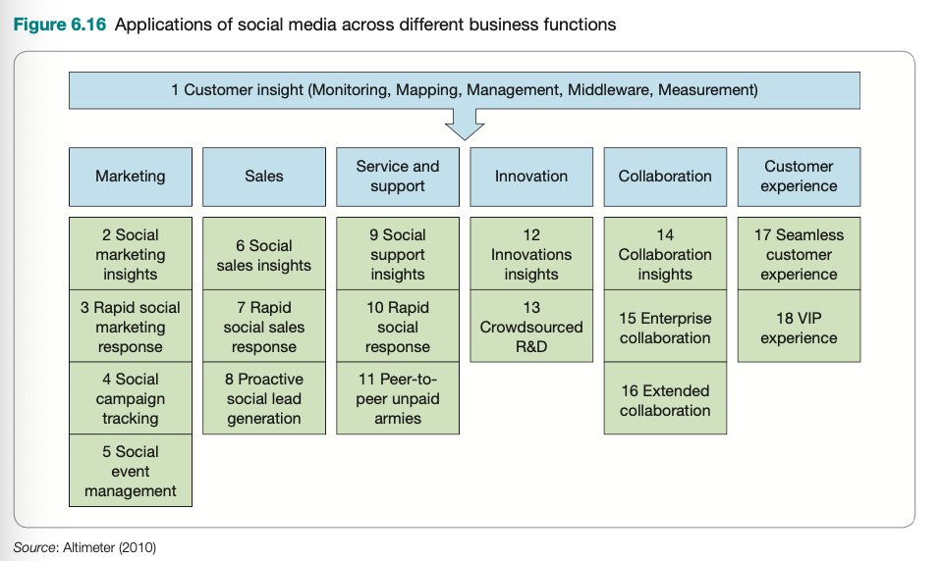
Social CRM
Dominant social platforms largely boxed out social CRM by changing APIs and limiting access.
- Facebook shut its door and broke many CRM integrations, and LinkedIn got choosy.
- The promise of social CRM as a way to automatically collect contact data and communicate on social platforms from within the CRM died a quick death.
_ Kowalke (2017)
Notes:
ứng dụng social media trong CRM trải dài ở rất nhiều các chức năng marketing khác nhau,
hình 6.16 mô tả một số các hoạt động chính của sử dụng insights từ social CRM
1 Marketing. Increasing awareness through social networks as described in Chapter 9. Monitoring, analysis and response of customer conversations through social listening tools.
2 Sales. Social selling plus understanding where prospects are discussing selection of prod- ucts and services offered by you and competitors, and determining the best way to get involved in the conversation to influence sales and generate leads.
3 Service and support. Customer self-help through forums provided by you and neutral sites.
4 Innovation. Using conversations to gain ideas for new product development or enhance online offerings.
5 Collaboration. Sharing insight from social media monitoring throughout an organisation using internal collaboration tools such as Slack.
6 Customer experience. This references the use of social CRM to enhance the customer experience and add value to a brand. Altimeter gives the example of using VIP pro- grammes offering collaboration between customers with shared characteristics to add value and create advocacy (Solis, 2011).
Note that the deep integration between social networks and CRM systems promised by social CRM when the social networks were growing rapidly in popularity has not been delivered in practice due to a combination of privacy concerns and social networks wanting to retain control, requiring advertising expenditure for marketers to communicate to their subscribers.

Slide 23
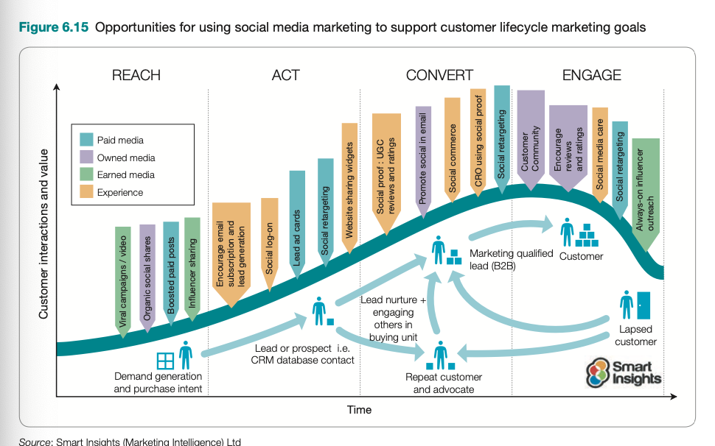
Opportunities for using social media marketing to support customer lifecycle marketing goals
Notes:
Social proof
Consumer psychology research shows that potential customers trust recommendations from others, so communicating social proof in different formats can increase conversion. Forms of social proof include customer reviews, ratings, testimonials and case studies, and independent validation by an
influencer or recognised trustworthy sources. Numbers showing the size of the company and brand idents can also communicate social proof.
Reach – increase awareness and grow an audience using paid, owned and earned media: Organic amplification of social updates by loyal customers, advocates and followers, plus organic viral marketing activities and targeted paid social buys such as boosted posts (see
• Chapter 9). Act – prompt interactions, subscribers and leads: Organic and paid social media encour- ages website visits that apply permission marketing to generate new database contacts. Some social networks such as LinkedIn and Twitter enable permission marketing within
• the social feed though lead ad cards. Convert – achieve sales online or offline: Nurture prospects and leads towards sale – ad retargeting using paid social media is particularly effective for this since it can be used to target an individual in a similar way to email nurture that is not possible with organic
• social media. Engage – encourage repeat business by developing customer satisfaction, loyalty and advocacy: Ad retargeting and uploading customer lists to social media platforms can also be used to target customers who have previously purchased. Encouraging custom- ers to write and share reviews of their experience is particularly important to encourage conversion of other customers using social proof.

Slide 24
Main social media platforms
Social network
Social publishing and news
Social streaming
Social reviews
Social commenting in blogs
Social customer service
Social customer communities
Social knowledge
Social search
Social commerce
Notes:
Organic social media marketing It’s common practice to distinguish between organic and paid social media marketing activities in a similar way to
organic and paid search marketing. Organic social involves using social networks and customer communities to develop relationships, share positive opinions through social media amplification and manage negative social media comments

Slide 25
Social media activities requiring management
1 listen and manage reputation;
2 transform the brand through social media;
3 acquire new customers;
4 increase sales to existing customers;
5 deliver customer service.
Notes:
Xác định chiến lược nghe và danh tiếng
Biến đổi thương hiệu qua social media – Transform the brand
Chiếm lĩnh khách hàng mới thông qua social media
Tăng doanh số từ khách hàng có sẵn
Củng cố dịch vụ khách hàng qua hoạt động marketing trên social media
1 listen and manage reputation;
2 transform the brand through social media;
3 acquire new customers;
4 increase sales to existing customers;
5 deliver customer service.
Activity 1. Define listening and reputation strategy
To develop a social media listening approach, you need to understand social media usage for each of:
your audience: who they are, how they participate, what they’re saying and sharing;
your activity: through official social media channels and interactions through your site, but also through employee mentions;
your competitors: for direct and indirect competitors, you need to review how their activities compare to yours;
online publishers and other key intermediaries: these are a form of indirect competitor and are also important as influencers.
Activity 2. Transform the brand through social media
To fully exploit social media across all functions will require companies to make major changes to their brand, company structure and how everyone in the company communicates.
Some key areas for delivering this transformation are:
Set scope for social media activities. Understand the intersection of social media and your business activities. It’s not just about your Facebook, Instagram, Twitter or LinkedIn
presence, it cuts across all customer marketing activities. Review social media capabilities and priorities. Social media marketing isn’t new for most companies, they will already be using social media. But they won’t be using it to the max. Benchmarking where you are now against where you want to be in the future is the key
to future success. Governance: define who is responsible for social media. We’ve seen that exploiting social media requires the involvement of many people in larger companies. So you need to
decide who does what and how different groups work together. Reviewing the personality of your brand and setting a vision. Social media and content marketing give many opportunities to make your brand more engaging, which have to be thought through. The whole personality of your brand may have to be revisited too.
Activity 3. Acquire new customers using social media
For most marketers, the ultimate appeal of social media marketing is to use it to increase sales through reaching new prospects and converting them to customers, as discussed further in Chapter 9.
Activity 4. Increase sales to existing customers
Applying social media to increase sales to existing customers focuses on developing your customer communications strategy to encourage more social interactions on your site, lead- ing to more social shares to gain the amplification effect.
Activity 5. Enhance customer service through social media marketing
Improving customer service or ‘social customer care’ through social media is not a major focus of this chapter since we focus more on communications that directly increase sales through reaching or converting more of an audience.
However, to find out more about how customer service can be delivered through social media, we recommend reading the advice of consultant Guy Stephens of Foviance (Chaffey, 2010). He talks about how specific customer service activities should be managed, including:
social listening to identify customers requiring service;
outreach to answer customer questions or resolve problems;
using service to improve product and service offerings;
management of a company’s own service forums or other service platforms such as Get
Satisfaction.

Slide 26
Case study 6
Buffer: from idea to paying business customers in seven weeks

Slide 27
Chapter reference
Chaffey D. & Ellis-Chadwick F. (2022). Digital marketing - Strategy, Implementation and Practice (8th edition), chapter 6. Pearson. UK

Slide 28


